Slide 1
Senior Prospects in New Canaan
Investment Committee, New Canaan Men’s Club
Paul A. Strassmann, February 29, 2016
Former Member of the Senior Executive Service, Federal Government
All Slides in Presentation by Strassmann, LLC

Slide 2
Investment Review

Slide 3
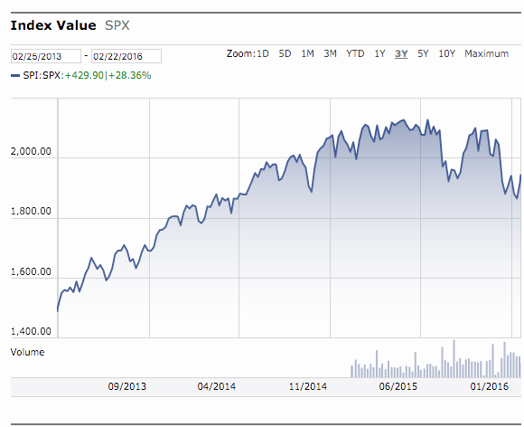
S&P 500 Was Increasing But is Currently Not Stable

Slide 4
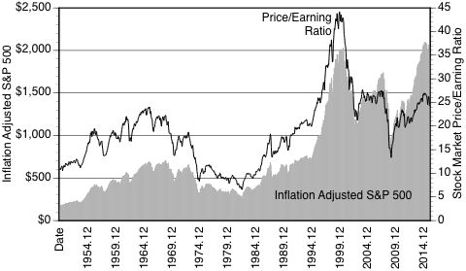
Overvaluation = S&P 500 Exceeds Price/Earning Ratio

Slide 5
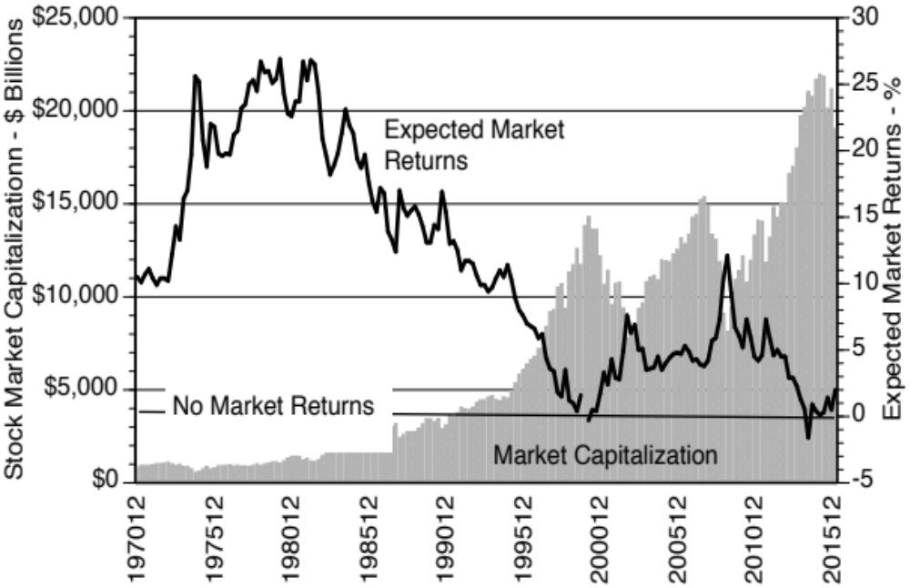
Overvalued Stock Market Reduces Market Returns

Slide 6
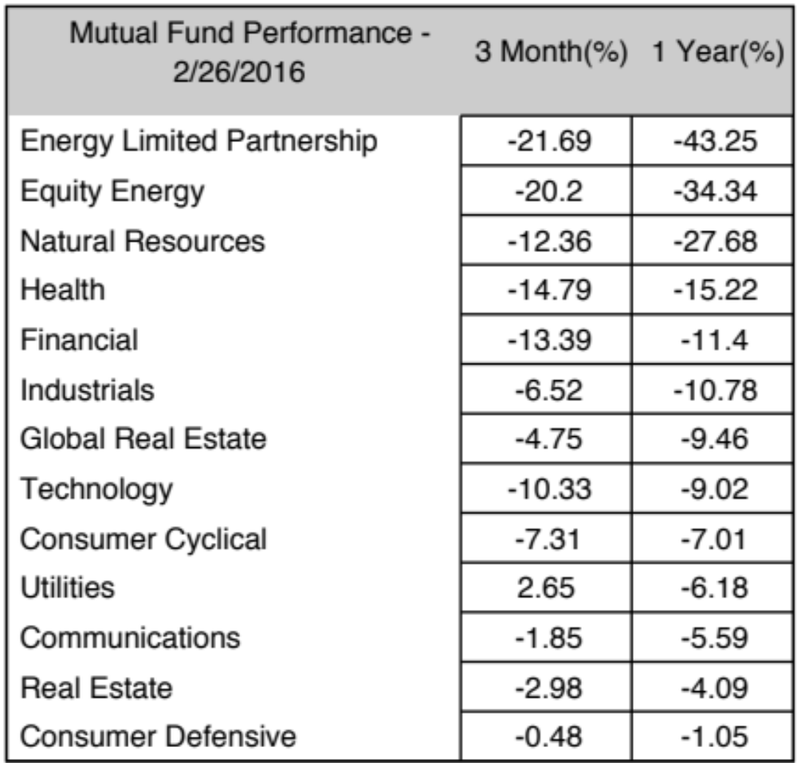
Recent Sector Performance Negative (02/27/2016)

Slide 7
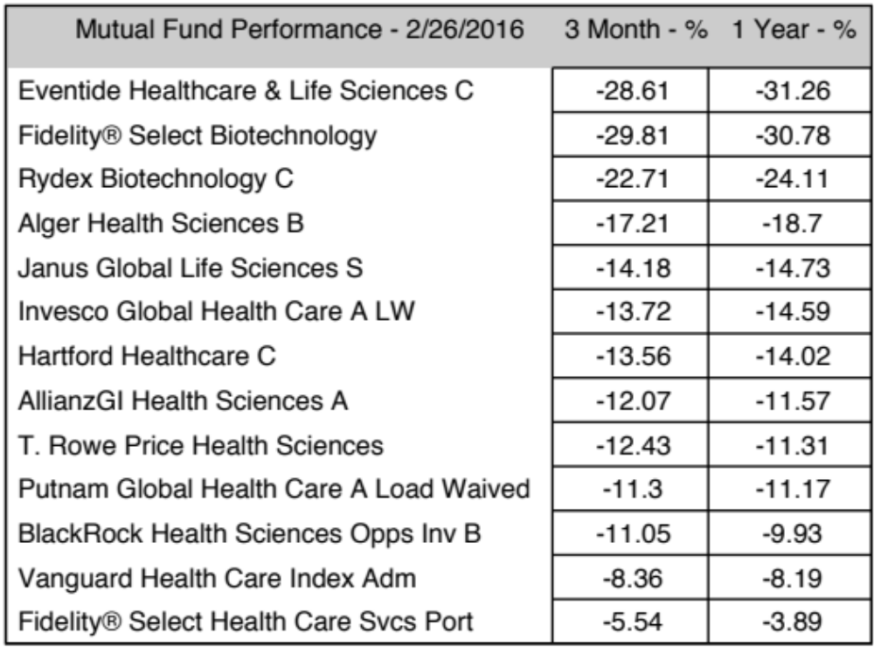
Performance of Recently Preferred Funds Negative

Slide 8
Summary
A downward adjustment of the stock market can occur.
Downside Portfolio Risks Are Likely to be Greater than Upside Potentials.
Senior Men Should Consider Protection Against Losses.

Slide 9
New Canaan Review

Slide 10
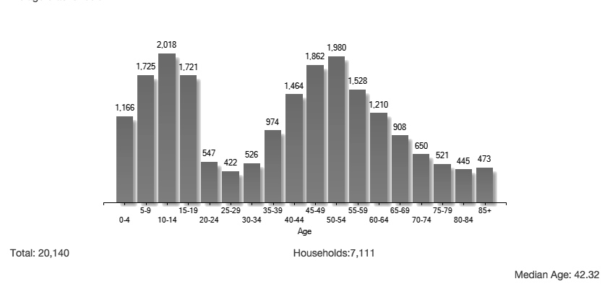
Children Do Not Stay in New Canaan – High Population Turnover
http://www.weichert.com/search/community/city.aspx?city=35757

Slide 11
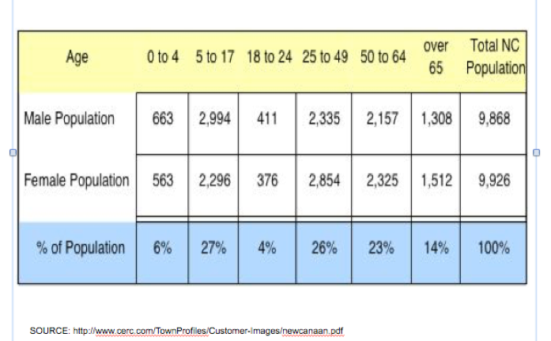
30% of the New Canaan Population in Schools

Slide 12
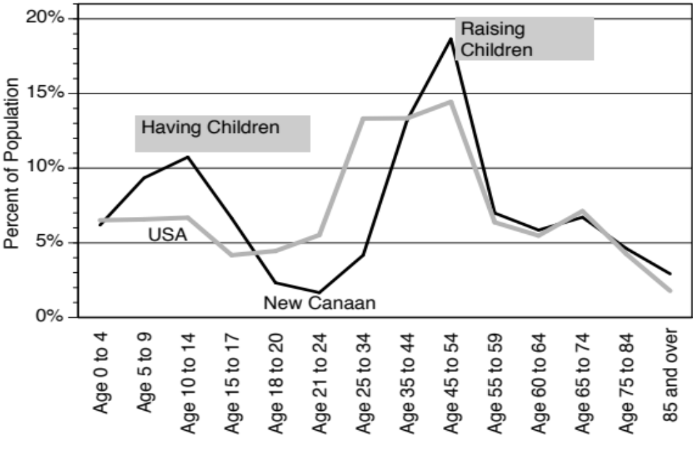
New Canaan is Child-Centered Dictating How Taxes are Managed

Slide 13
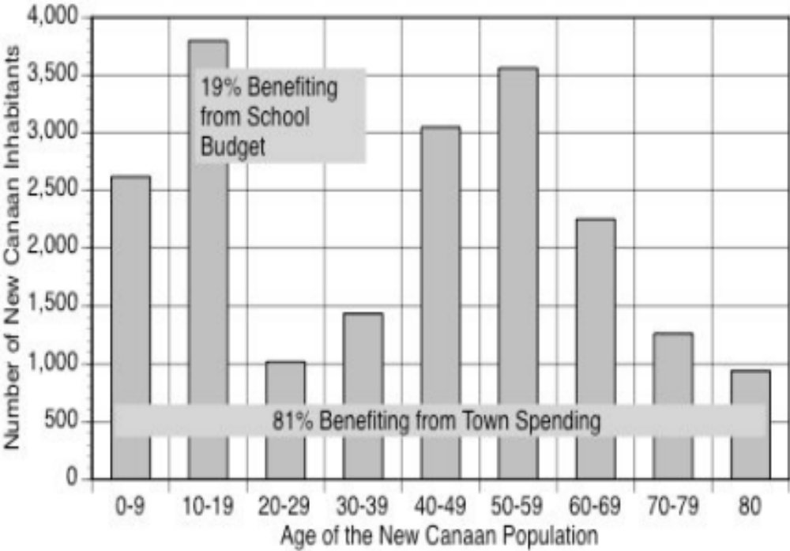
59% of New Canaan Budget Spent on 19% of the Population

Slide 14
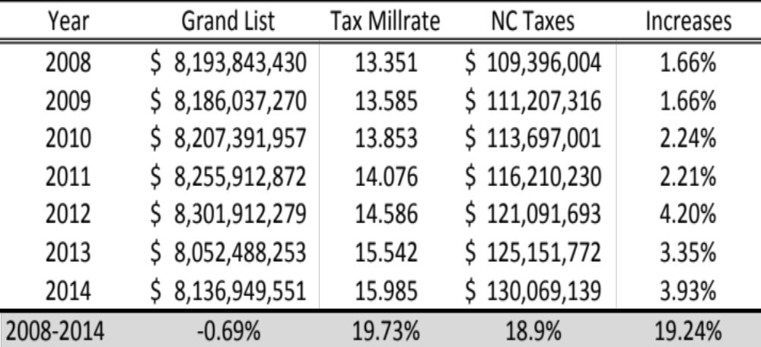
New Canaan Taxes Rise Faster Than Home Values
SOURCE: Sebastian Caldarella, Town of New Canaan Assessor, 6/9/2015

Slide 15
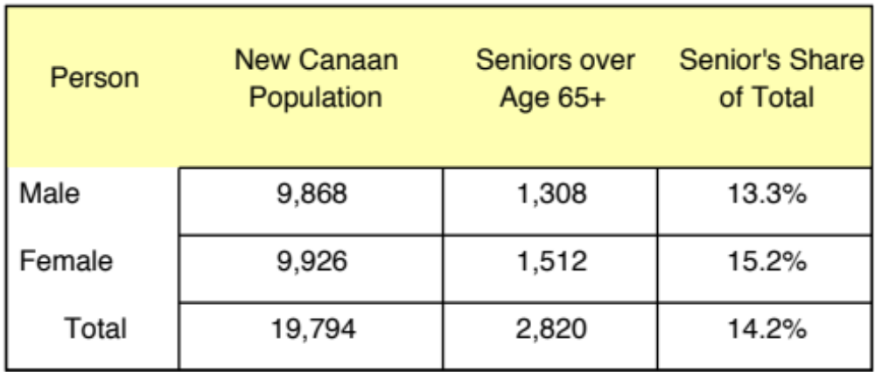
New Canaan Seniors Have a Large Share of the Population
USA Population 65 Years and Older : 13%
http://www.cerc.com/TownProfiles/Customer-Images/newcanaan.pdf

Slide 16
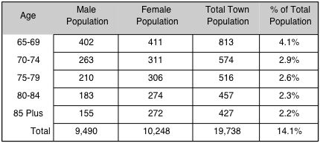
There are Over 2,787 Seniors Over 65 Live in New Canaan

Slide 17
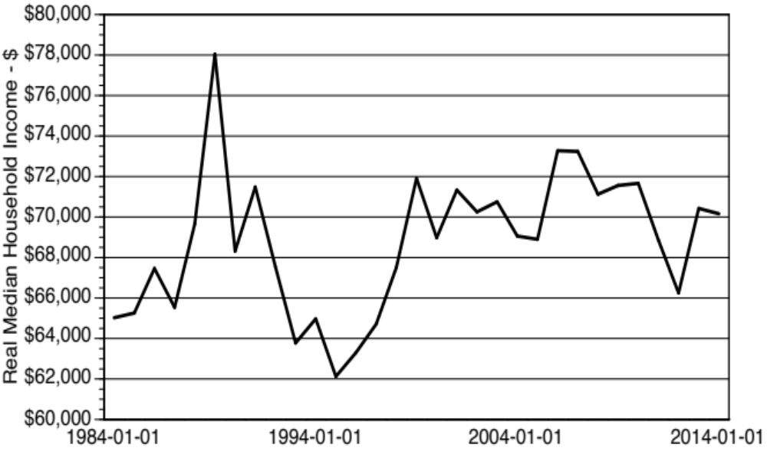
NC Inflation Adjusted Household Income Remains Stagnant
SOURCE: https://research.stlouisfed.org/fred2/series/MEHOINUSCTA672N#

Slide 18
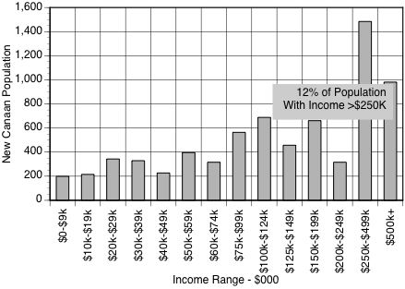
New Canaan Incomes Are Concentrated over $100K/year
http://www.realtor.com/local/New-Canaan_CT/lifestyle

Slide 19
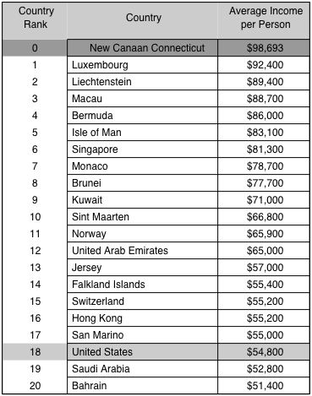
New Canaan Still Remains a Location Where to Live

Slide 20
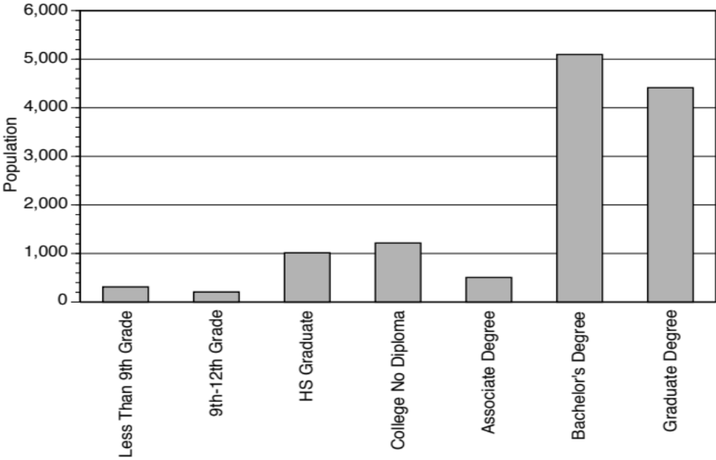
Education Level of New Canaan Adults is Superior
http:/n/www.realtor.com/local/New-Canaan_CT/lifestyle

Slide 21
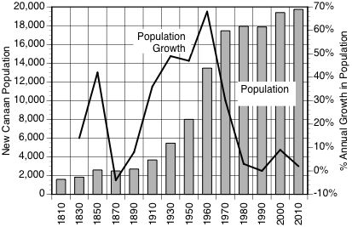
New Canaan Population Growth is Now Below 4%/Year
http://en.wikipedia.org/wiki/New_Canaan,_Connecticut#The_.22Harvard_Five.22_and_modern_homes

Slide 22
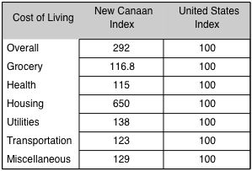
http://www.bestplaces.net/cost_of_living/zip-code/connecticut/new_canaan/06840
High Cost of Living In New Canaan Reflects Housing Costs

Slide 23
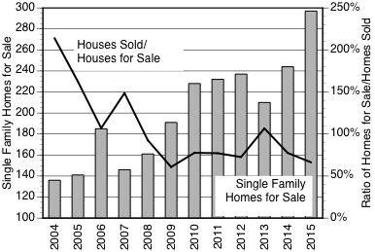
New Canaan the Ratio of Homes Sold Declines

Slide 24
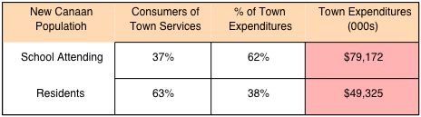
Allocation of Town Expenditures

Slide 25
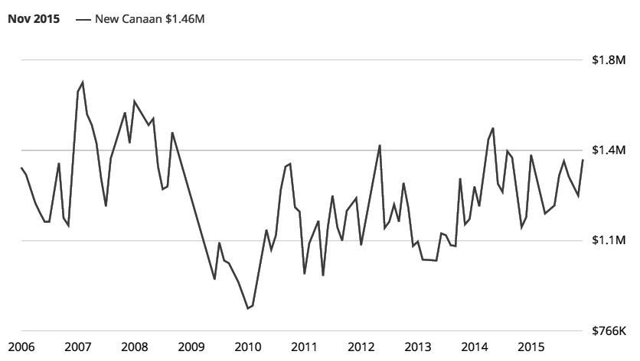
Real Estate Sale Prices in New Canaan Have Not Recovered
http://www.zillow.com/new-canaan-ct/home-values/

Slide 26
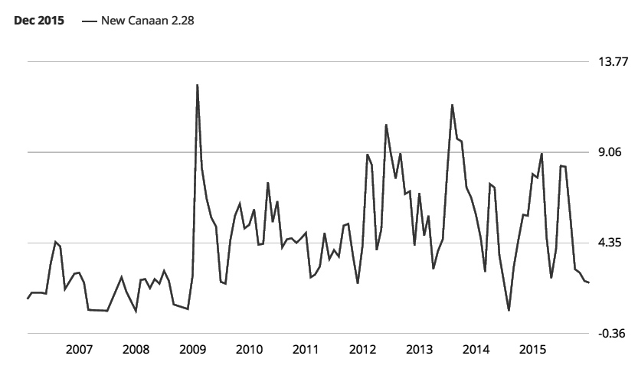
New Canaan Foreclosures
http://www.zillow.com/new-canaan-ct/home-values/

Slide 27
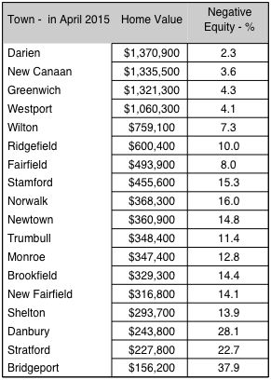
New Canaan Home Ownership Shows Small Negative Equity

Slide 28
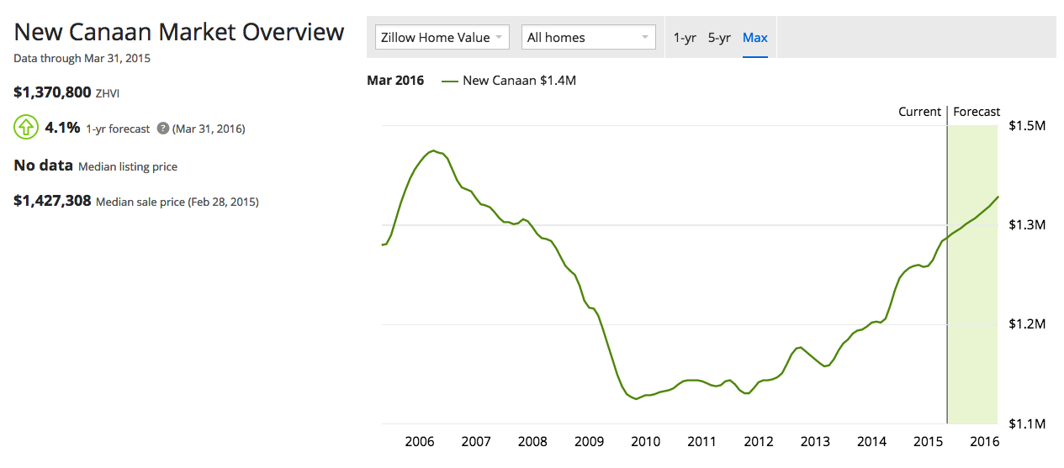
Are New Canaan Homes a Good Investment?
-12%
http://www.zillow.com/new-canaan-ct/home-values/

Slide 29
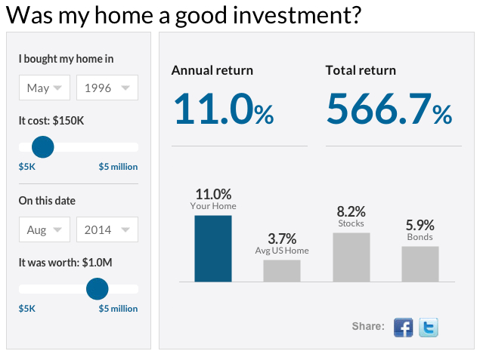
http://money.cnn.com/calculator/pf/home-rate-of-return/

Slide 30
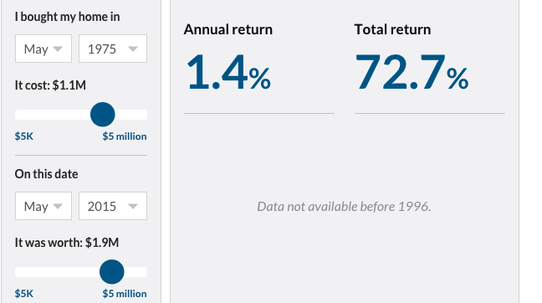
40 Yr Inflation Adjusted Pre-Tax Returns of Only 1.4%/yr
http://money.cnn.com/calculator/pf/home-rate-of-return/

Slide 31
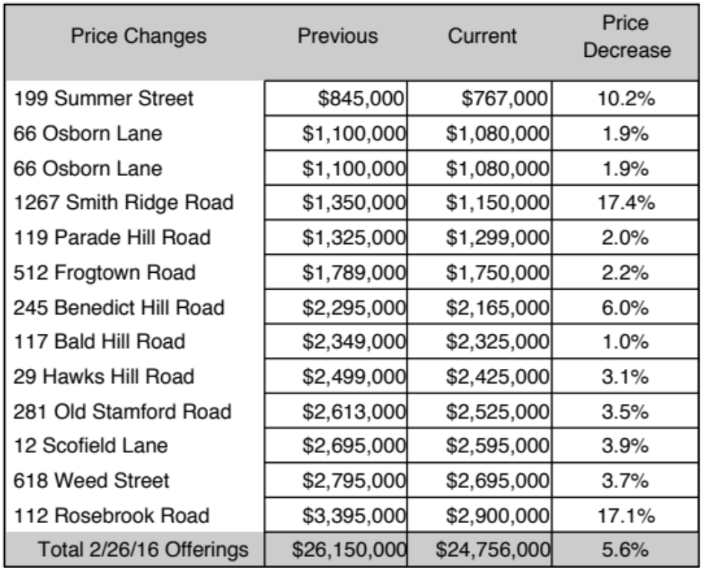
Example of Current 5.6% Price Cut of New Canaan Homes
SOURCE: ebergmans@houlihanlawrence.com

Slide 32
High Turnover of New Canaan Real Estate
Annual Residential Turnover 12 %
5+ Years in Residency 50 %
Median Years in Residency 4.96
640 Homes of 7,260 Homes for sale = 8.8%,

Slide 33
Town Budget Interference from the State of Connecticut
Town not allowed to cut Board of Education budget
State makes it easy for Unions to litigate
Part time contractors must become employees
State imposes cap on NC Operations tax increase
NC Board of Education Exempt from limit on taxes
SUMMARY: State of CT Adds to NC taxes

Slide 34
Observations about New Canaan
Population Growth Less than 4%, Tax Base Stagnant
Real Estate Stagnant While Taxes up 19% in Four years
Personal Income Declines While Inflation is up 3.5%/year
Appreciation of Homes is Less than the Cost of Interest
Large Number - 8.8% of Homes on the Market
Price of Homes Does Not Reflect Rise in Education Costs
Education Costs of >$21,000/Student Equals UConn Tuition
$148 million Operating Budget Favors Allocation to Minority

Slide 35
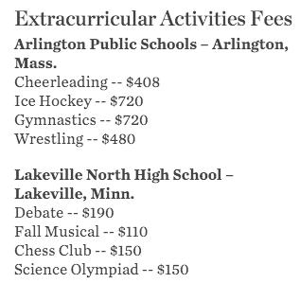
Potential Remedy
SOURCE: http://www.wsj.com/articles/SB10001424052748703864204576313572363698678

Slide 36

Cost Management Solutions
SOURCE: http://www.wsj.com/articles/SB10001424052748703864204576313572363698678

Slide 37
Town of New Canaan 2016 Finances
$ 148 million operating budget, increases 5.47%
$ 5.1 million capital budget, increases 109%
Town of New Canaan is the town’s largest business.
The Town’s financial position is deteriorating.
Seniors living in New Canaan at a premium cost

Slide 38
Books and Articles: http://www.strassmann.com
Blog: http://pstrassmann.blogspot.com/
Presentation Posted on: http://smcnc.org
Next Club Presentation: May 2, 2016
Disclaimers:
The Strassmann LLC is not a broker, dealer, or investment adviser.
Under no circumstances does any information posted herein represent
a recommendation to buy or sell a security. The information on this site
does not constitute investment advice or recommendations.
In no event will Strassmann LLC be liable to any reader or third party
for any damages of any kind arising out of the use of any of this content,
including without limitation of any investment losses. The information
on this site is not guaranteed for completeness or accuracy.

